Slide 1
KMITL Residence
Group#8

Slide 2
Flow 1: Reservation
UI: Check Availability

Slide 3
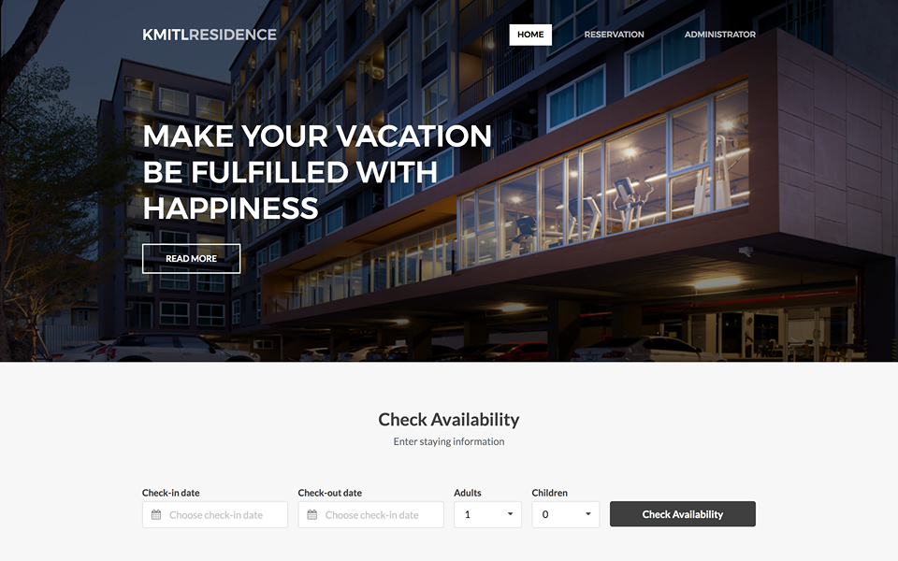
UI: Check Availability

Slide 4
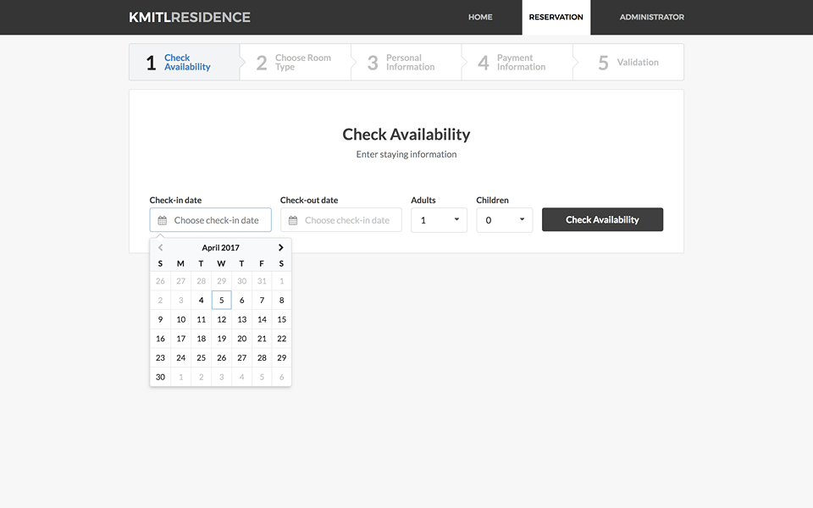
UI: Check Availability

Slide 5
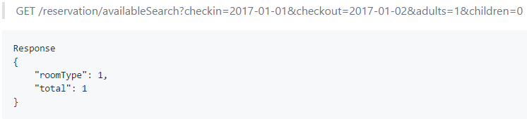
Flow 1: Reservation
UI: Check Availability
Reservation Service
API: availableSearch
checkin
checkout
adult
Table: reservation

Slide 6
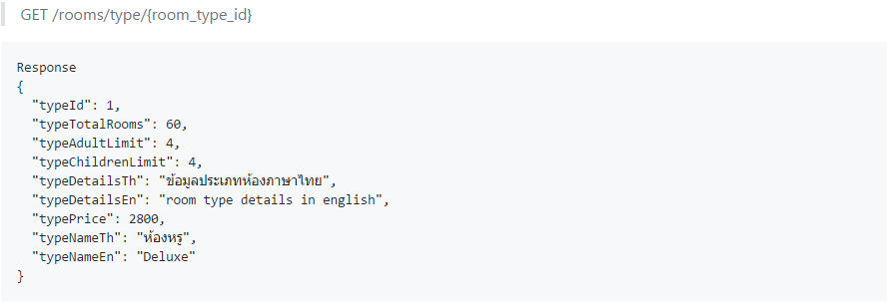
Flow 1: Reservation
Reservation Service
API: availableSearch
Room Service
API: type
Table: room_type

Slide 7
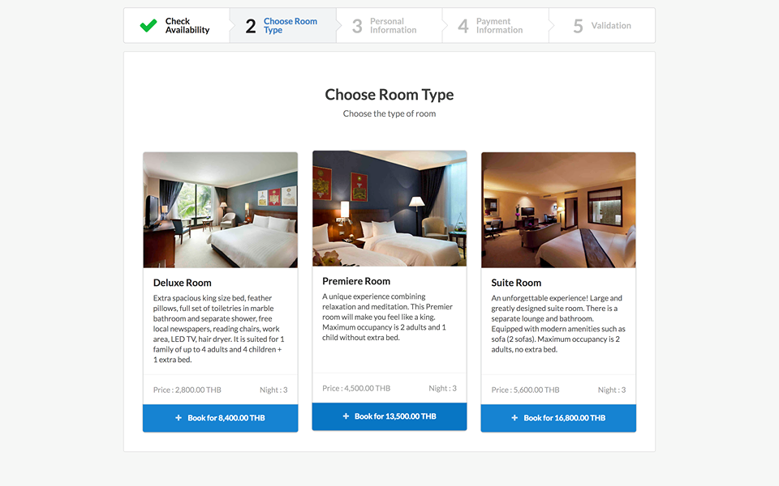
UI: Choose Room Type

Slide 8
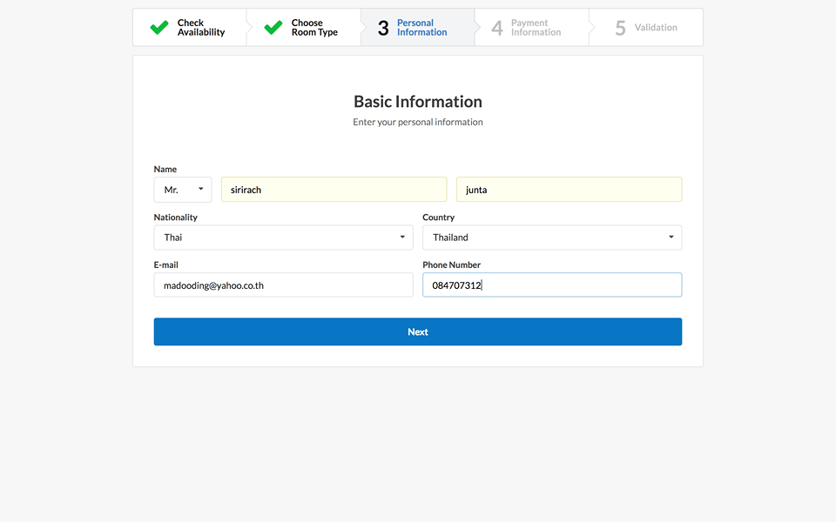
UI: Personal Information

Slide 9
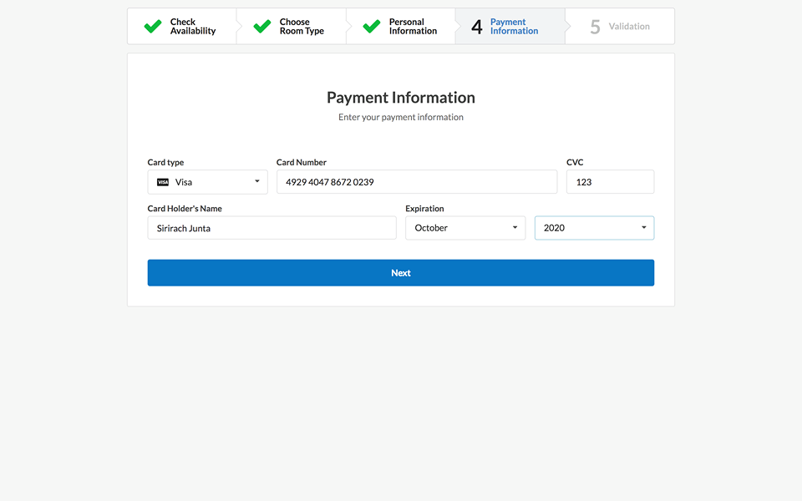
UI: Payment Information

Slide 10
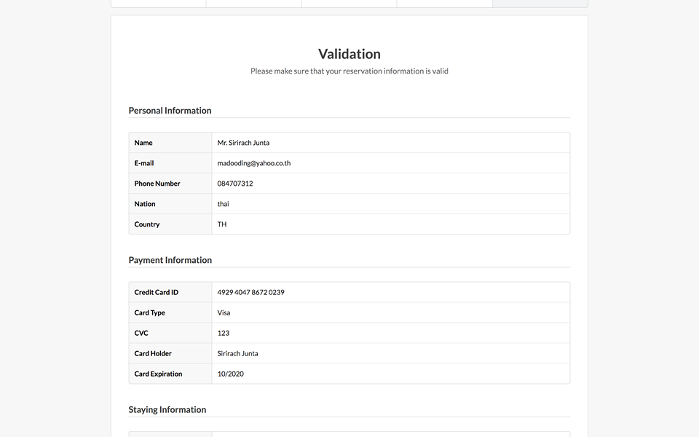
UI: Validation 1

Slide 11
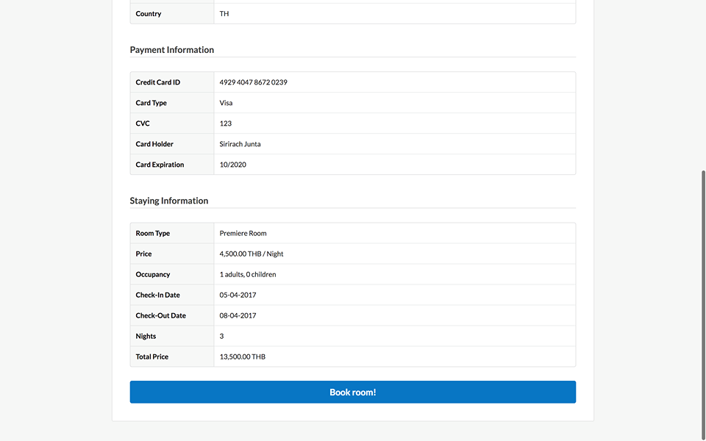
UI: Validation 2

Slide 12
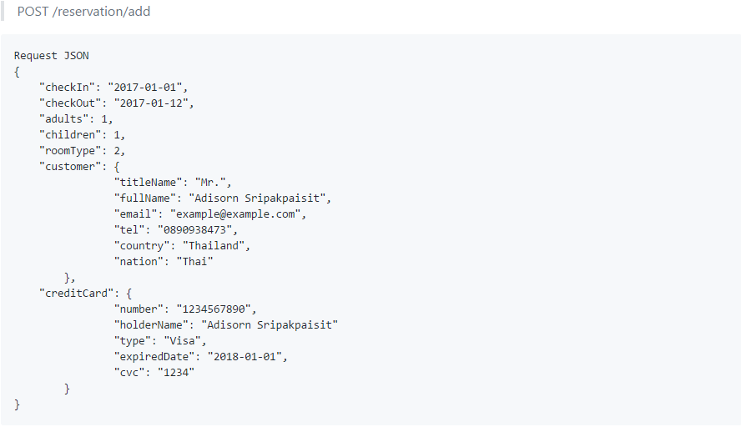
Flow 1: Reservation
UI: Validation
Reservation Service
API: add
Table: reservation

Slide 13
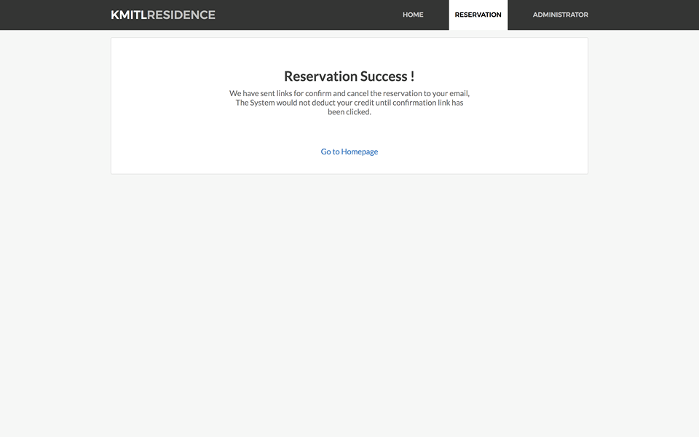
UI: Reservation Success

Slide 14
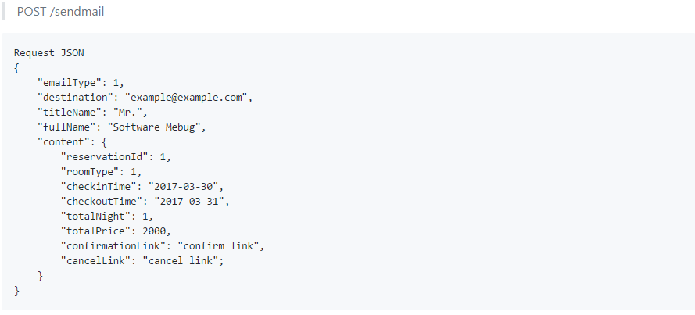
Flow 1: Reservation
Reservation Service
API: add
Email Service
API: sendmail
Table: reservation

Slide 15
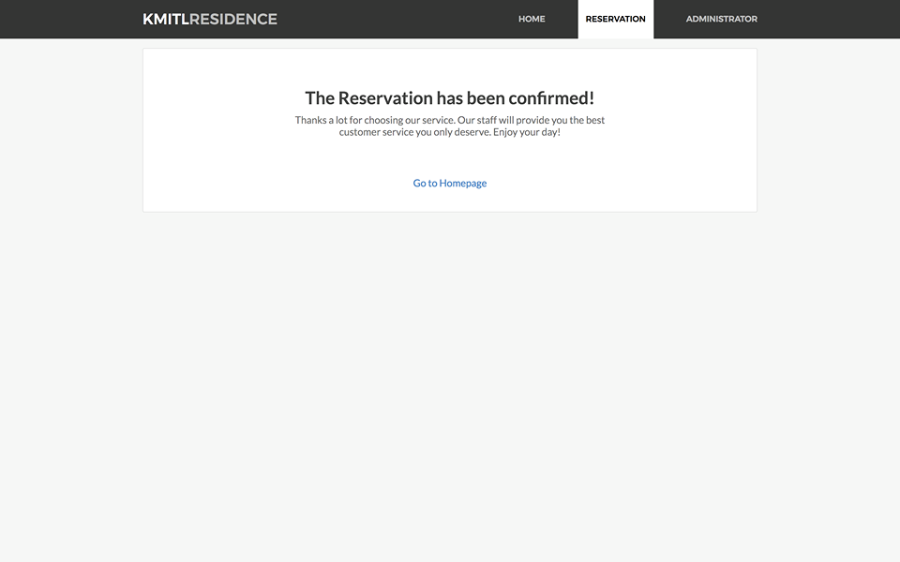
UI: Reservation Confirmed

Slide 16

UI: Reservation Cancelled

Slide 17
Q&A

Slide 18

Agenda
Features
UI
Services
APIs
Endpoint name
Request format
Response format
Database

Slide 19

1. Features
Room Finding
Relax a sensational room in the best hotel of ladkrabang district.
Hotel Booking
Easily book hotel rooms at the best real-time rates.
News
A source and distribution point for the latest news in KMITL Residence.

Slide 20
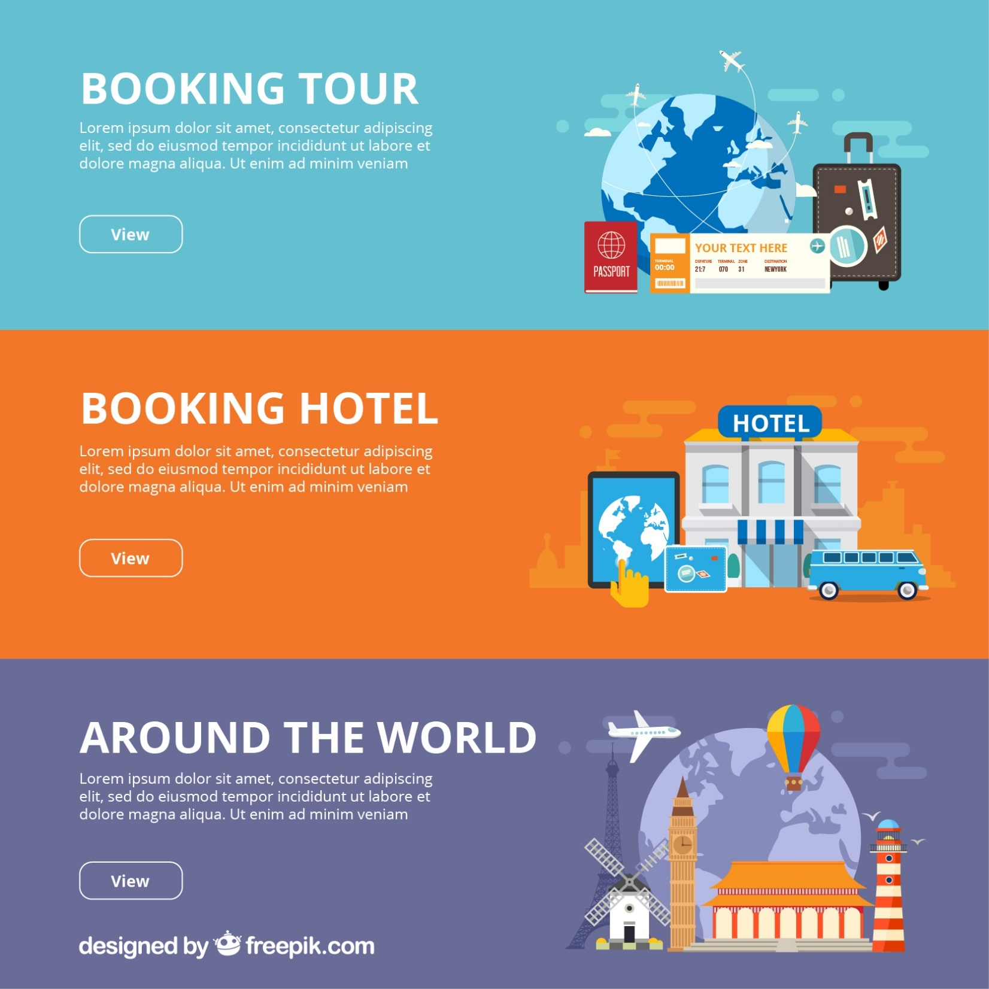
1. Features
Online Payment
Secure online payment processing services through credit card and internet banking.
Guest Review
More feedback with review express of KMITL Residence.
Summary
Analyze summary transactional data by our staffs.

Slide 21

3. Services
Room Service
Reservation Service
Email Service
User Service

Slide 22

3. Services (Room Service)

Slide 23
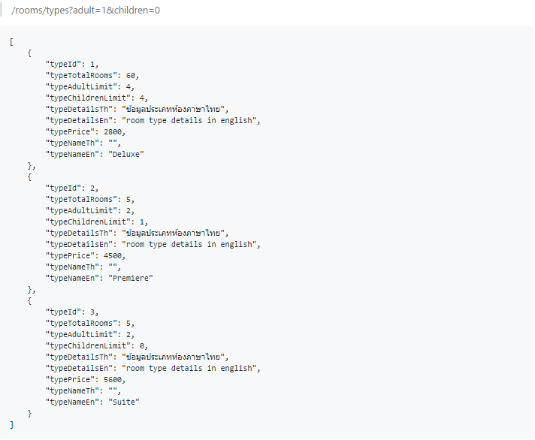
3. Services (Room Service)

Slide 24
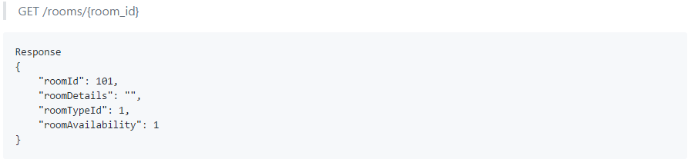
3. Services (Room Service)

Slide 25
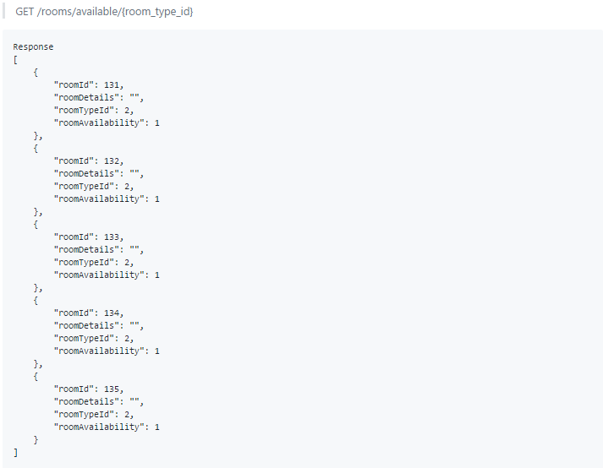
3. Services (Room Service)

Slide 26
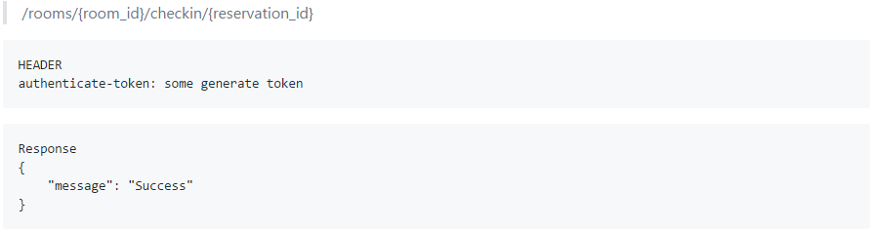
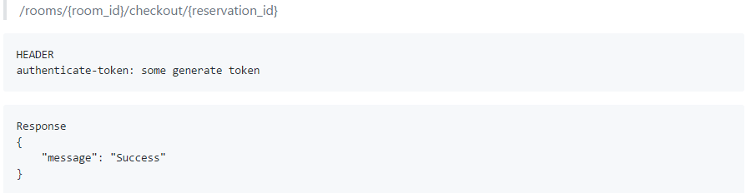
3. Services (Room Service)

Slide 27
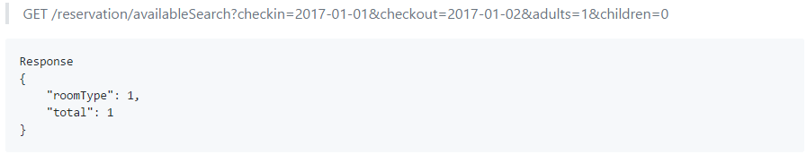
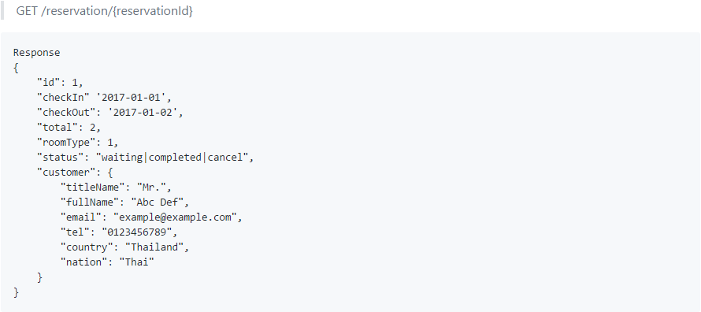
3. Services (Reservation Service)

Slide 28
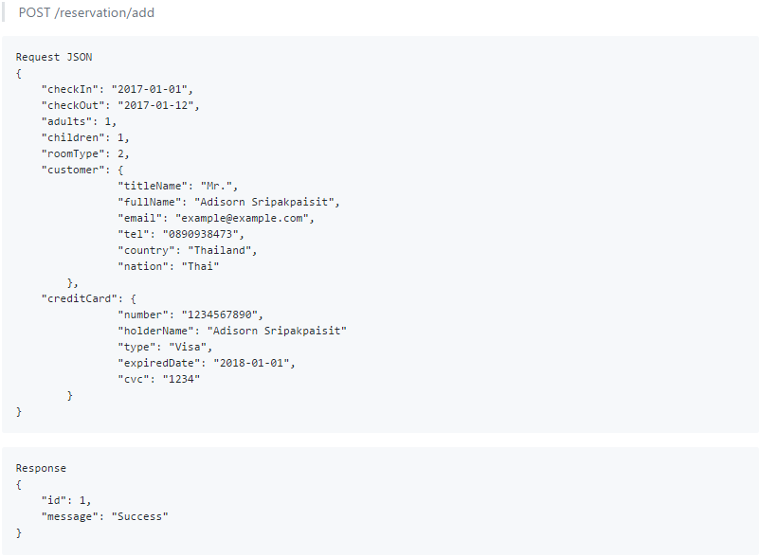
3. Services (Reservation Service)

Slide 29
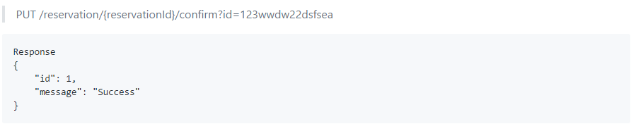
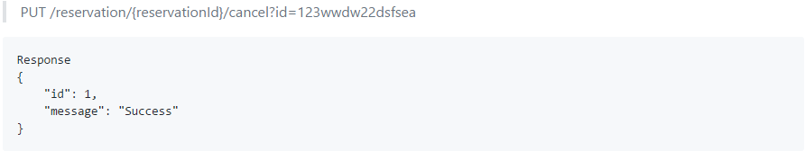
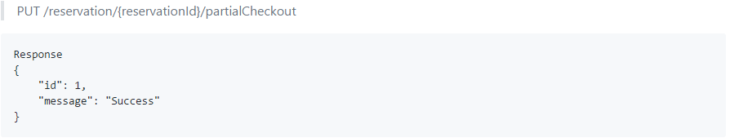
3. Services (Reservation Service)

Slide 30

3. Services (Email Service)

Slide 31
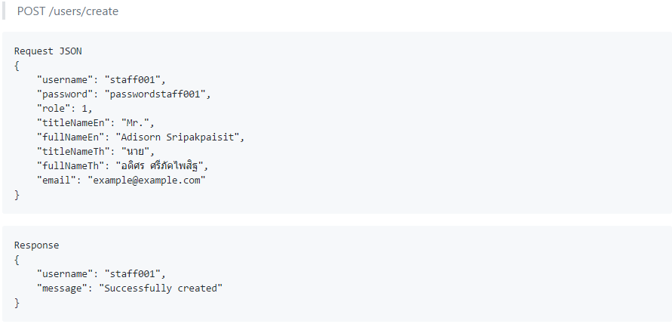
3. Services (User Service)

Slide 32
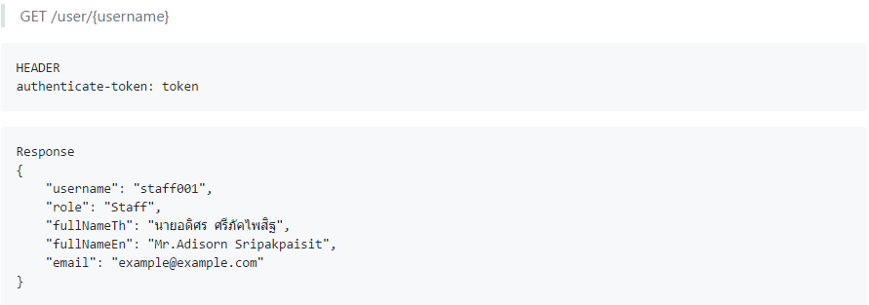
3. Services (User Service)

Slide 33
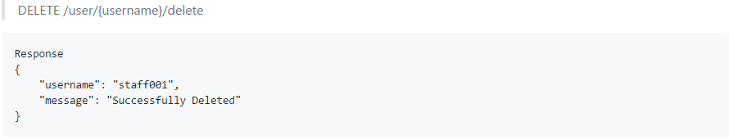
3. Services (User Service)

Slide 34
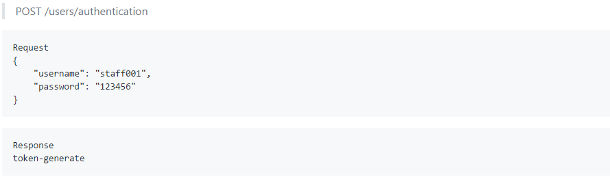
3. Services (User Service)

Slide 35
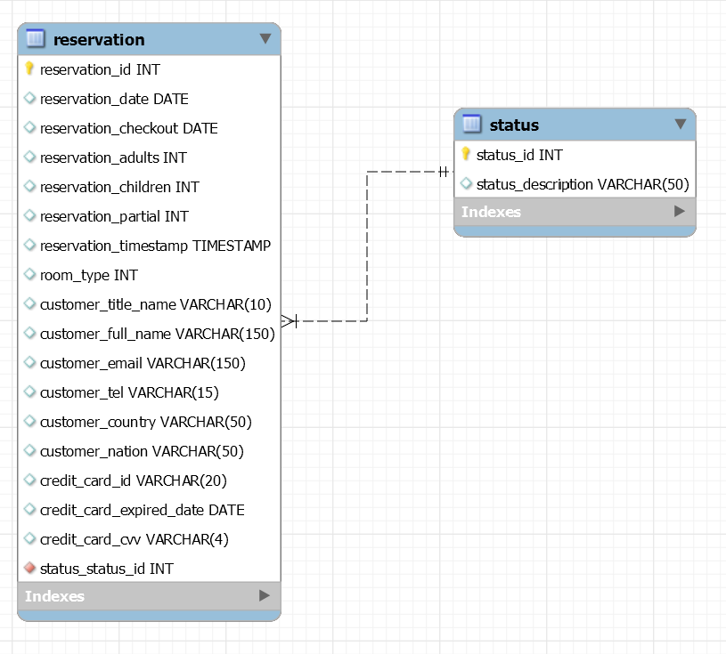
4. Database
Reservation Service

Slide 36
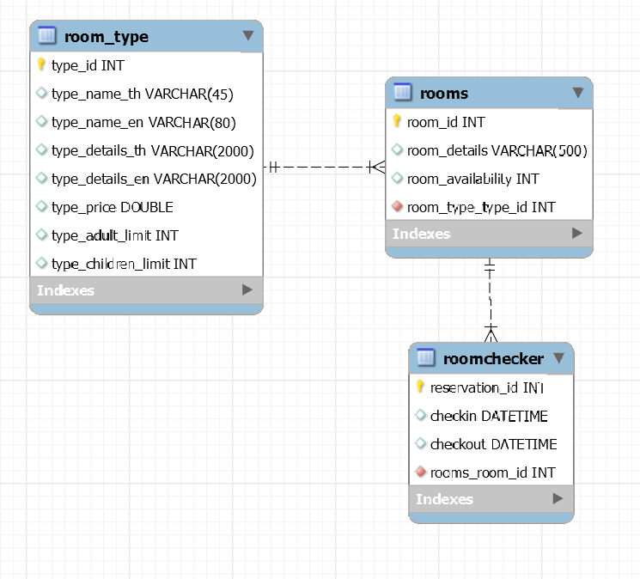
4. Database
Room Service

Slide 37
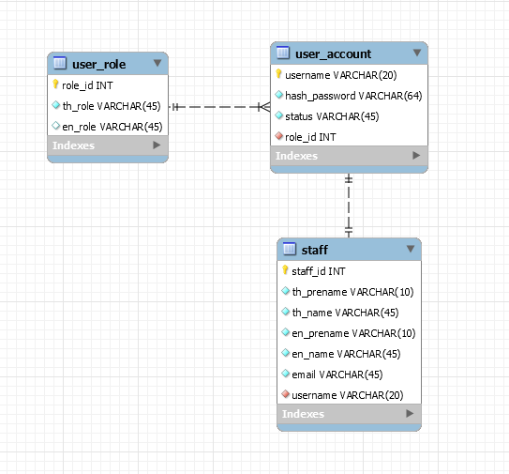
4. Database
User Service

